Slide 1
09 | Automation in scale - Remoting
Jeffrey Snover | Distinguished Engineer & Lead Architect
Jason Helmick | Senior Technologist, Concentrated Technology

Slide 2
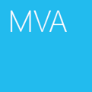

Course Topics
Getting Started with PowerShell
01 | Don’t fear the shell | 06 | The pipeline : Deeper
02 | The Help system | 07 | The Power in the Shell - Remoting
03 | The pipeline : Getting connected | 08 | Getting prepared for automation
04 | Extending the shell | 09 | Automation in scale - Remoting
05 | Objects for the Admin | 10 | Introducing scripting and toolmaking

Slide 3
Module Overview
Reusable Sessions
Sessions with Invoke-Command
Real-world deployment of a website
Getting commands from anywhere

Slide 4
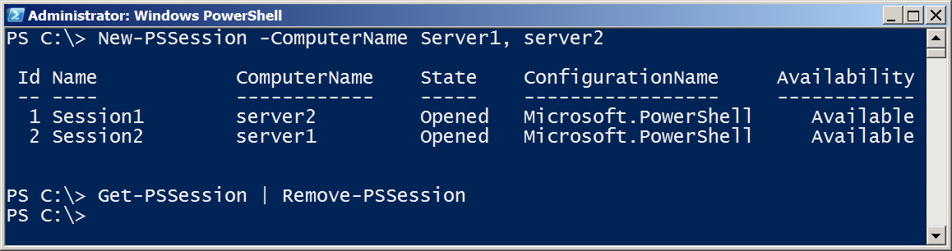
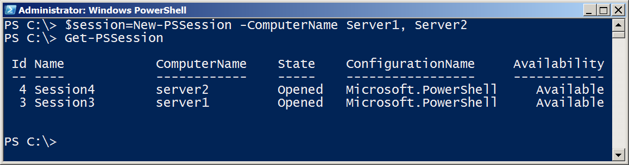
Reusable Sessions
Can be disconnected and reconnected in PowerShell V3

Slide 5
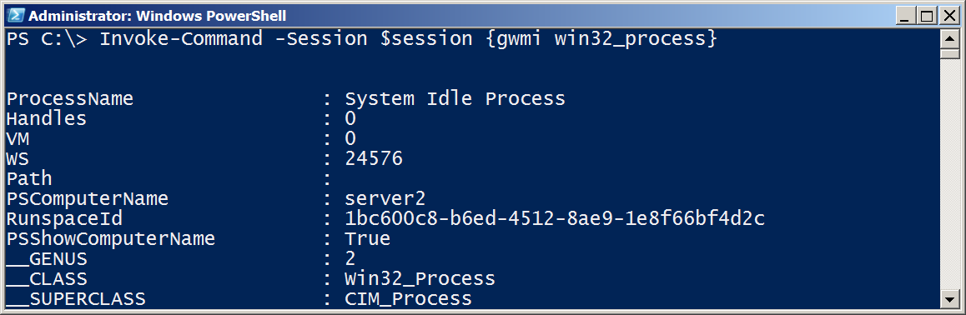
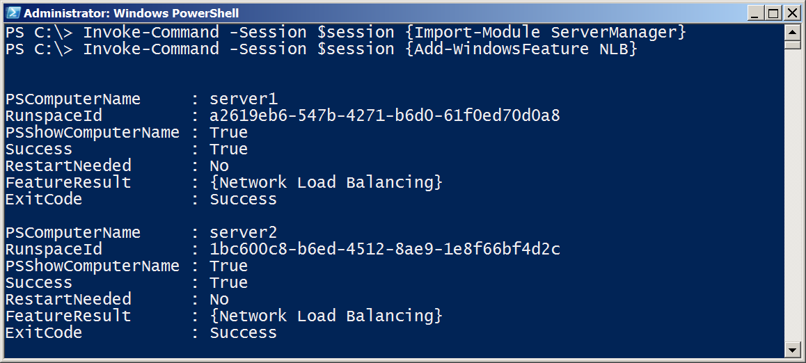
Sessions with Invoke-Command

Slide 6
Real-world deployment of a website
Demonstration

Slide 7
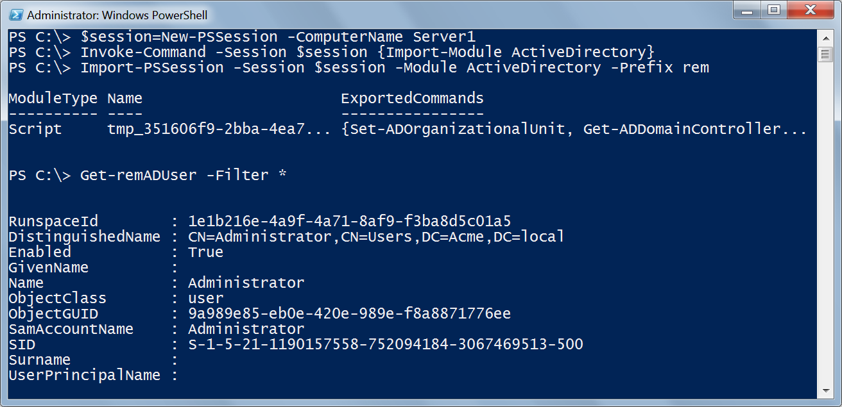
Getting commands from anywhere - Implicit Remoting

Slide 8
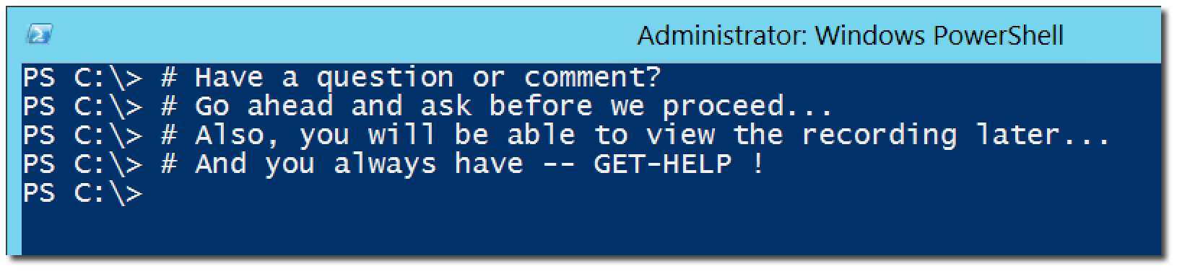
Questions or comments?

